Slide 1


EXAMPLE
Store, Build, Deploy – AzureDevOps & CRM Customizations
Brandon Winchester
Senior Manager, Sustained Engineering
Blackbaud

Slide 2
Azure DevOps & CRM Customizations
What is Azure DevOps?
How can we use it?
Who is this session for?
Anyone in the software development lifecycle
For those that are already doing these things, nice work!
For those that are not doing these things, start small!
Blackbaud CRM custom SDK development

Slide 3
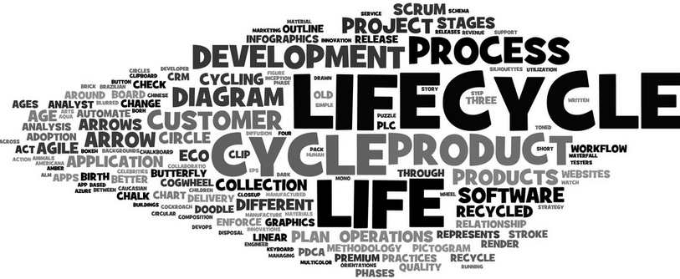
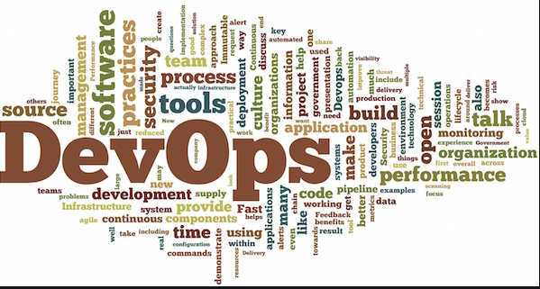
What is Azure DevOps?
Microsoft’s tool(s) to cover the entire application lifecycle with DevOps capabilities as a central, core theme
Software Development Lifecycle
DevOps
Notes:
IT Revolution and GitHub for images

Slide 4
What is Azure DevOps?
Microsoft Azure DevOps
Azure & Azure DevOps Services
ADO
Concepts and features
Azure DevOps: Work Items, User Stories, Pipelines, Merges, Releases, Pushes, Repos, Builds, Commits, Pulls, Feeds, Artifacts (and so on)
Best Practices, Recommendations, Consultants, Visions, Infographics, Anecdotes, Agreements, Complaints, Word Clouds and Disagreements
For today, our context is Blackbaud CRM custom solutions created with the Infinity SDK but could be anything
Are we really going to cover all of those?
Code storage
Project builds
Solution deployment
Ideas
Recommendations

Slide 5
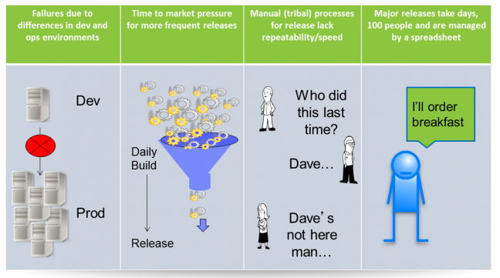
Why Azure DevOps?
Traditional methods or practices
Manual processes prone to error
Slow, many steps easy to skip
High risk
New framework and methodology
Improved quality of deliverable
Increased accountability
Automation (efficiency, reliability)
Risk mitigation
Centralization
Notes:
Havelena.com: IT Enthusiast with passion for Business and Innovations // IBMer interested in Management and Leadership

Slide 6
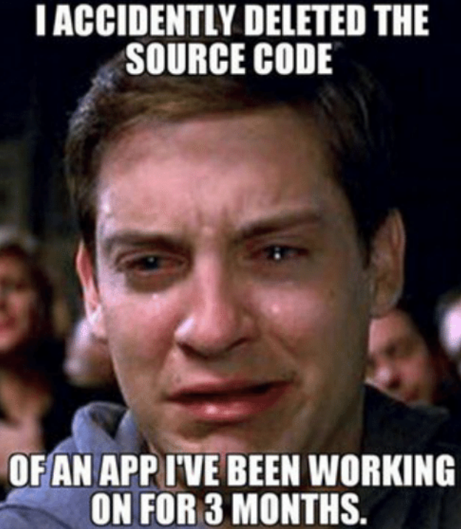
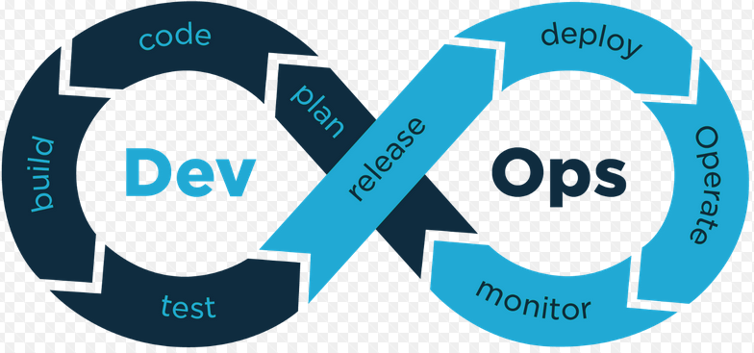
Azure DevOps - Store code
Code repository
Repository hosting Microsoft Azure
Version control (file archive and retrieval)
Release management
Workflow
Quality Assurance
Version control
Team Foundation Service aka TFSVC
Git
Branch Strategy
Minimal two branches
Adding branches adds overhead

Slide 7
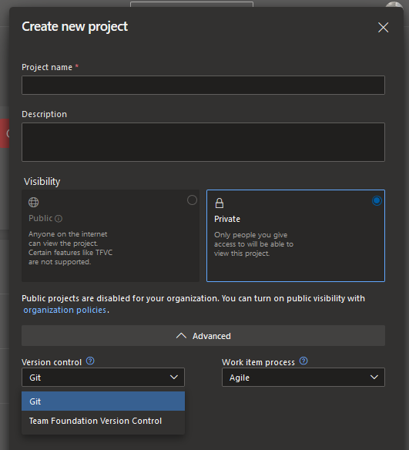
Store code – Version Control
Team Foundation Version Control
Was the original
Historical favorite
Git
The new upstart
Fast becoming the industry standard
Which one?
Pick one that your whole team agrees on
Trends in the industry
Be open about scope and resources
Lot of opinions, know the facts
Pick a good fit for your organization
Recommendation?

Slide 8
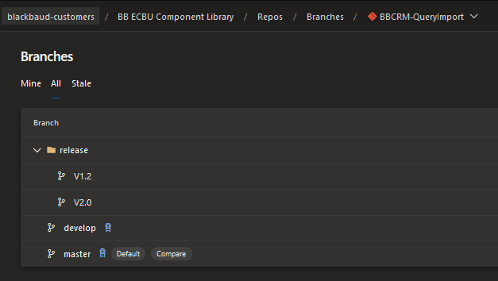
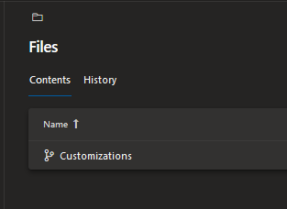
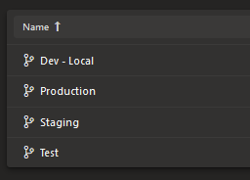
Store code – Branch Strategy
Branches
Development vs Production
Recommendations
Start simple
One is the loneliest wrong number
Branches matter...but too many can add overhead
Need organizational buy-in, will define workflow
Develop\Release\Master
Idea: Create branches based on your environment

Slide 9
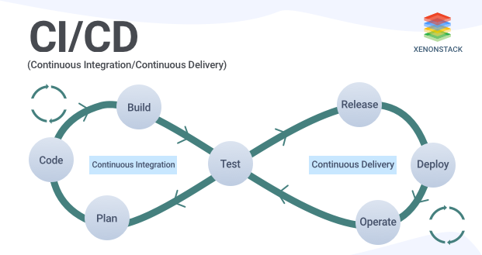
Azure DevOps - Build solution
Azure DevOps to run builds – Pipelines
MS Build
Continuous Integration
First step on a journey
Builds succeeding or failing
Emails on status
Options for your Organization

Slide 10
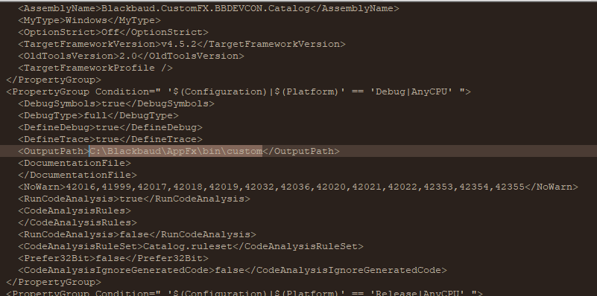
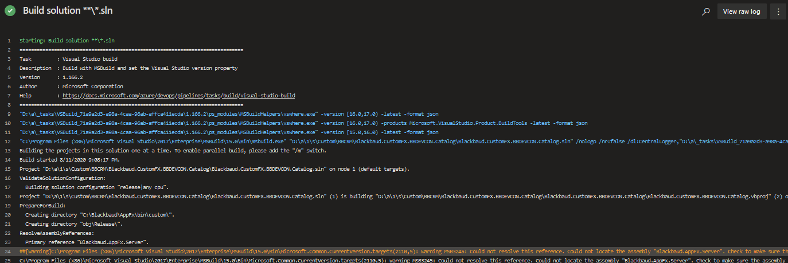
Azure DevOps - Pipeline
Watch your build location
SDK integration will set the build location, make sure you change it
Remember the SDK dll references

Slide 11
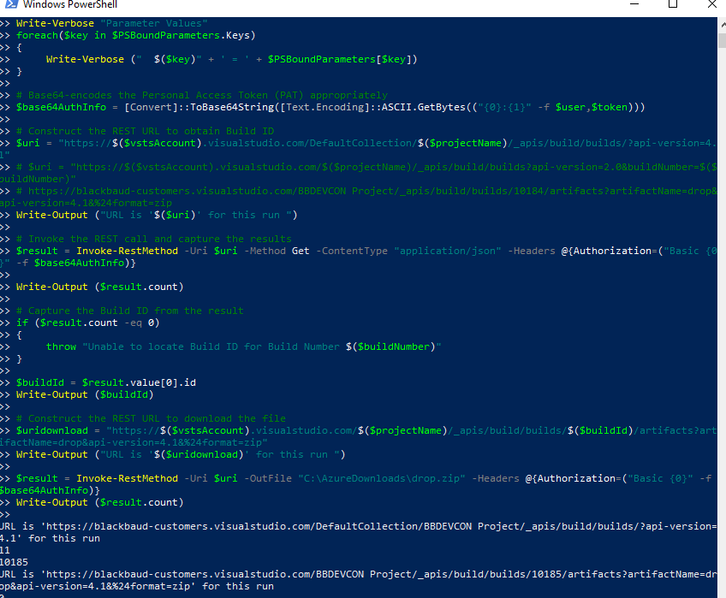
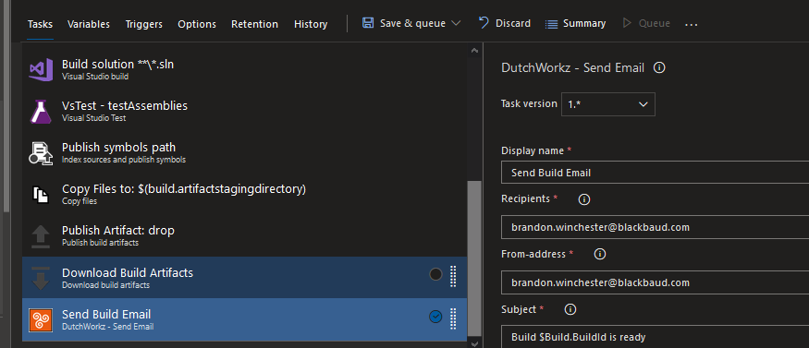
Azure DevOps - Deploy solution
So…where are my files?
https://<URL>/_apis/build/builds/<your build>/artifacts?artifactName=drop&api-version=4.1
https://blackbaud-customers.visualstudio.com/_apis/build/builds/10184/artifacts?artifactName=drop&api-version=4.1
You can script the above (Powershell) if you want to automate…or just download
Send an email with a link
Or create a Release pipeline….

Slide 12

To learn more about Azure DevOps, code repositories, Pipelines and Releases go to:
https://bitbucket.org/product/code-repository
https://docs.microsoft.com/en-us/azure/devops/repos/tfvc/comparison-git-tfvc?view=azure-devops
https://azure.microsoft.com/en-us/services/devops/
https://docs.microsoft.com/en-us/azure/devops/pipelines/?view=azure-devops
https://docs.microsoft.com/en-us/azure/devops/pipelines/process/environments?view=azure-devops

